Slide 1
Neural Age
John A Drakopoulos

Slide 2
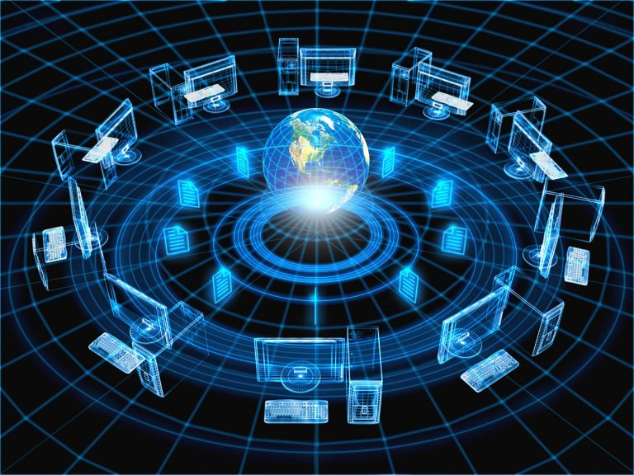
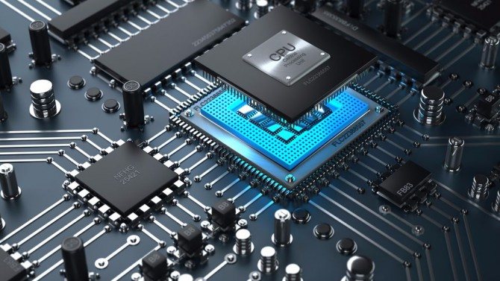
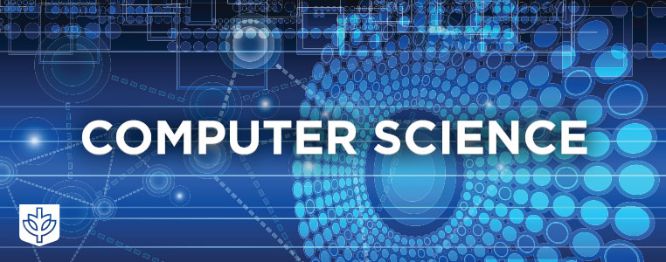
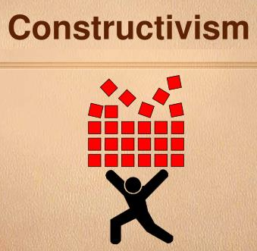
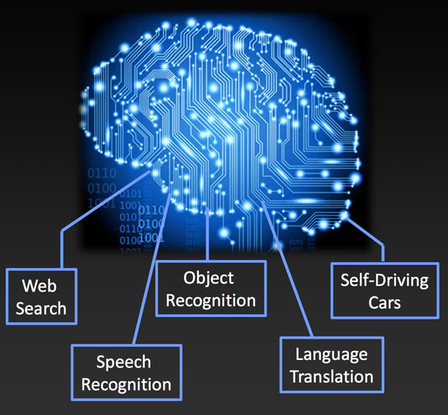
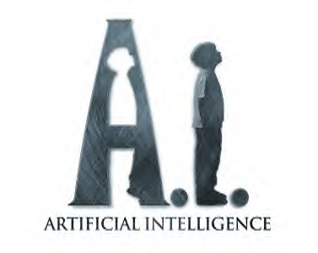
Neural Age -- Plot and Cast
Based on a true story.
A world immersed in computing | An invention that has no equal | An incredibly successful field | A lucrative industry
An extraordinary prejudice | An inevitable (r)evolution | And a brave neural future

Slide 3
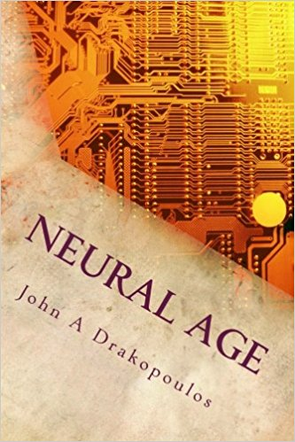
Neural Age
New era: throughout the 21st century, neural networks will transform art, science, and society.
Affected Areas:
Manufacturing Construction Engineering Agriculture Finance Commerce Security Defense | Transportation & Warehousing Politics Arts Sports & Entertainment Education Computer Science | Biology Medicine & Healthcare …
Available:
Online: fairkryn.com/cetera/neural.html
Book: www.amazon.com/Neural-Age-John-Drakopoulos/dp/1975649680

Slide 4
Neural Age Overview
The book contains 7 chapters.
The rise of neural networks A brief history of neural networks.
The epidemic of constructivism A constructivist bias that has dominated the software industry.
Anti-neural prejudice An anti-neural prejudice in computer science.
Learning versus intelligence The relationship between change, learning, and intelligence.
The dawn of the neural age Current and future applications of neural networks.
The jeweled city on the horizon Future of neural networks and technological impact in the 21st century.
The less traveled road Long-term social impact of neural networks.

Slide 5
Chapter 1.
The rise of Neural Networks

Slide 6
The Rise of Neural Networks
Common neural network types
X |  | 𝞢₀ | 𝜑₀ | … | 𝞢_{H} | 𝜑_{H} |  | Y
X |  | 𝞢₀ | 𝜑₀ | … | 𝞢_{H} | 𝜑_{H} |  | Y
 |  | 𝞢₀
 |  | 𝞢₀
A feed-forward neural network (FNN) is a composition of alternating polynomial (𝞢) and non-polynomial (𝜑) functions.
A convolutional neural network (CNN) is an FNN with one or more iterative polynomial transformations.
X |  | 𝞢₀ | 𝜑₀ | … | 𝞢_{H} | 𝜑_{H} |  | Y
X |  | 𝞢₀ | 𝜑₀ | … | 𝞢_{H} | 𝜑_{H} |  | Y
 |  | 𝞢₀
 |  | 𝞢₀
A recurrent neural network (RNN) is an FNN with one or more backward connections.
A recurrent convolutional neural network (RCNN) is both convolutional and recurrent.

Slide 7
The Rise of Neural Networks
Neural networks are fundamental mathematical and computational constructs
Sequence of instructions, loops, recursion.
The novelty, if any, is in the learning part
Neural nets learn their functionality from the data (they can adapt their structure too...)
Learning is not new
Fisher's linear discriminant: 1936.
Perceptron algorithm:, 1957.
Back-propagation: 1986; variants: 1960s, 1970s, and early 1980s
CNNs: 1980s, inspired by receptive fields, Hubel and Wiesel in 1950s and 1960s, published in 1968.
RNNs: 1980s; Hopfield network, appeared in 1974, popularized in 1982.
Credit assignment problem: apply a reward or penalty to learned parameters.
Harder with distance between parameters and outcome.
Acute problem with recurrent or deep neural networks; solved (to a large extent) in 1990s.
Sparse features: features that are absent from most samples (e.g. words in a text or speech).
Word embeddings: appeared in 1957 in linguistics, introduced to neural networks in 2000-2003.

Slide 8
The Rise of Neural Networks
Sparse features to embeddings
Embeddings are mappings from a high to a low dimensional space that preserve certain relations.
Word embeddings preserve semantic relations. Firth, 1957: “a word is characterized by the company it keeps.”
A computational form of understanding of words/human language.
Supervised and unsupervised learning
Teacher vs. self-learning, accuracy vs. data size.
Large labeled sets (e.g. ImageNet)
Deep neural networks (a.k.a. deep learning, AI, new electricity, tsunami, revolution etc.)
Foundational blocks of the neural enterprise.
Critical milestones:
A CNN with word embeddings for natural language processing (NLP) tasks in 2011.
A large CNN (600,000 units) for ImageNet in 2012.
Subsequently: dramatically increased interest in NNs, great gains in various domains.
Some experts declared metaphorical revolutions and tsunamis.

Slide 9
The Rise of Neural Networks
Slow progress
Relatively simple developments took an excessive amount of time:
More than 50 years from the perceptron to the current enterprise.
Perceptron algorithm to back-propagation ≃ 30 years
Receptive fields to CNNs ≃ 20 years
CNNs to CNNs with embeddings ≃ 30 years
Embeddings to neural networks ≃ 45 years
Comparison: if quantum physics were as inefficient a paradigm, it would have taken one more century to achieve the current level of mathematical sophistication.
Raising questions
Why have neural networks been such a slow paradigm?
Why is the neural enterprise taking place now? (A popular topic in on-line discussions and forums, surrounded by various myths and fallacies.)
We will attempt to answer the questions and dispel the myths in chapter three.
1950s
Embeddings
Perceptron
1960
Receptive Fields
1970s
1980s
Back-propagation
CNNs, RNNs
1990s
2000s
2010s
Large CNNs for vision
Deep NNs
Embeddings + NNs
Embedings + CNNs

Slide 10
Chapter 2.
The epidemic of constructivism

Slide 11
The Epidemic of Constructivism
Constructivism is essentially a rejection of autonomy
As an artistic and architectural philosophy, it originated in Russia circa 1913 and it was a rejection of autonomous art.
In science and engineering, constructivism postulates the existence or necessity of creators (usually scientists or engineers).
Constructivism has been omnipresent in engineering, its success primarily based on human ingenuity.
Inevitably, the output of a constructivist process is limited by the ability of its postulated agents.
There are limitations to human intellect as there are limitations to any computing entity.
Computer Science/Software Engineering
Has taken constructivism to a new extreme that defies the existence of such limitations.
Let us examine this condition in more detail.

Slide 12
The Epidemic of Constructivism
Modern operating systems contain 50 million lines of source code or more
An engineer who produces 200 lines/day, 5 days/week, and 48 work weeks/year, would need about 1042 years to write the code.
We need to add time for
Development testing and debugging
Quality assurance
Performance analysis and monitoring
Communication overhead and redundancy (if multiple engineers are involved in the project)
Code maintenance (if the project extends into many months or years)
Documentation
The total estimate is multi-thousand person-years to implement such large code.
If such a project is to be designed/implemented in the course of few years, thousands of employees are required.
Raising questions
Is software really that large? Does it have to be that large?
Is it possible for humans to engineer projects at such scale?

Slide 13
The Epidemic of Constructivism
Constructivism does not scale
When thousands of engineers work in a multi-million-line project, each engineer:
is responsible for a tiny part of it
has a limited understanding and range
can only treat the vast majority of the code as a black box
the temporal nature of employment aggravates the problem

Slide 14
The Epidemic of Constructivism
Constructivism is a liability
Over-partitioned projects are projects that are partitioned in as many parts as to make comprehensive definitions and understanding impossible.
Over-partitioned projects are a liability.
No one can:
have a comprehensive view of the project.
guarantee correct usage.
identify all the interactions in the system.
even name all the components.
Code becomes an enormous black box with unknown numbers of glitches and vulnerabilities.
The software industry constantly patches up their code issuing regular or urgent updates. (This is so common nowadays that it is no longer considered worth to be mentioned in the news.)
Consumers:
have been conditioned or forced to accept such products.
pay premium prices that factor in the excessive engineering costs.
Constructivism is the source of the problem: at large scale, it necessitates over-partitioning.

Slide 15
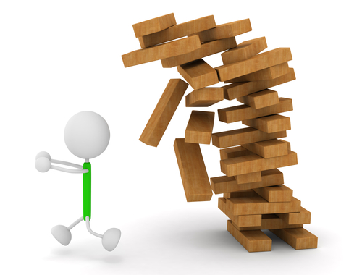
The Epidemic of Constructivism
Constructivism is a guest who has overstayed his welcome
The constructivist bias has dominated/impaired computer science and the software industry.
Efforts to improve human software engineering, such as
object oriented programming
open source
…
merely translate the limits and postpone the inevitable.
Constructivism has also eroded style and aesthetics
Compare the elegance and brevity of C/UNIX with modern systems and formalisms.
The ability of humans to create well-designed systems reduces with the complexity of the system
Exhaustion: when teams struggle to make a system work without embarrassing glitches and vulnerabilities, elegance and aesthetics become a luxury.
Conclusion
Any science or engineering that aspires to address structural complexities of arbitrary scale cannot primarily depend on constructivism.

Slide 16
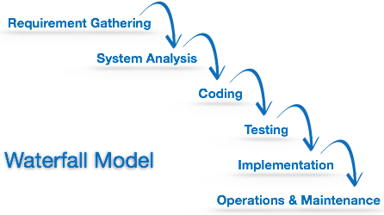
The Epidemic of Constructivism
Constructivist bias affects organization and perspective
Waterfall models are sequential processes where information flows easily in one direction -- down like in a waterfall -- but not in the other.
Upward changes (e.g. from feedback or the use of the system to the design) are hard or impossible to implement without a re-design.
Databases are such an example:
In order to create a database, we will need a schema (a set of formulas that specify the facts that can enter the database and their form).
Changing the schema of an operating database may involve significant re-engineering.
On distributed databases, data may even have to migrate physically.
Compare with human memory:
If our brains operated like databases, newborn children would have to predefine the form and structure of all potential memories that could be stored in their brains before they even have any memories!

Slide 17
The Epidemic of Constructivism
The next infrastructure unicorn
If the emphasis in computer science was on learning and autonomy, databases would be different:
Data would enter an initially empty database as associations between various items.
The associations would be periodically re-organized and re-indexed based on their frequency and short-term and long-term usage.
This is what seems to happen in human brains. (Memories are re-organized during sleep to minimize the cost and energy consumption for their retrieval.)
Even if we accept the current database technology as a substrate:
We can train a neural network to re-organize and re-index the database based on its use.
A hybrid approach with external memory that is managed by a neural network -- as in the differentiable neural computer. (It is unnecessarily convoluted but it is a step in the right direction...)
NLU neural networks can be used to turn user descriptions into queries.
Yet, all of this potential remains unexplored for it lies beyond the limited horizon of constructivism. The associated bias has deprived us from vision and rationality. And worse:

Slide 18
Chapter 3.
Anti-neural prejudice

Slide 19
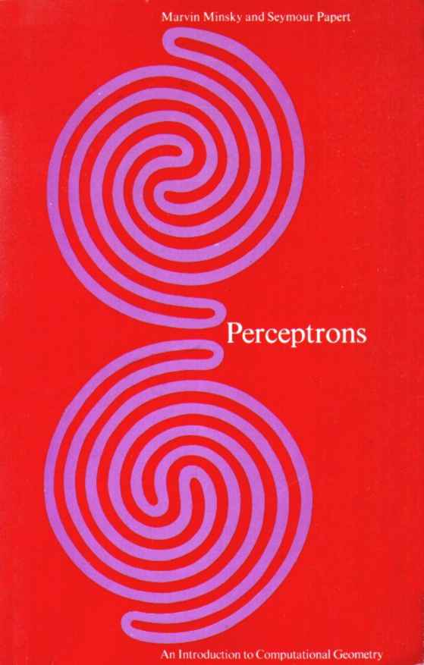
Anti-Neural Prejudice
Sentence first -- verdict afterwards.
An extraordinary degree of hostility and prejudice against neural networks in computer science and artificial intelligence.
It started in late 1950s as a feud with heated quarrels in academic conferences (between F. Rosenblatt and M. Minsky).
It reached a critical point with the publication of a deleterious book titled "Perceptrons: an introduction to computational geometry" in 1969.
There is hardly any scientific contribution in the above book.
A central result -- that a linear function could not model a non-monotonic function -- is trivial and it has been known for centuries.
The underlying monotonicity facts are as trivial and they were well-known.
The book’s elaborate proof , perhaps a pretension of discovery, raises questions about the authors.
Proposition. If P(a,b) and X(a,b) are a perceptron and the exclusive-or function with binary inputs a, b, respectively, then P(a,b) cannot be equal to X(a,b), for all a, b. | Proof. P(0,b) and P(1,b) are functions of b with the same monotonicity. However, X(0,b) and X(1,b) are an increasing and a decreasing function of b, respectively.

Slide 20
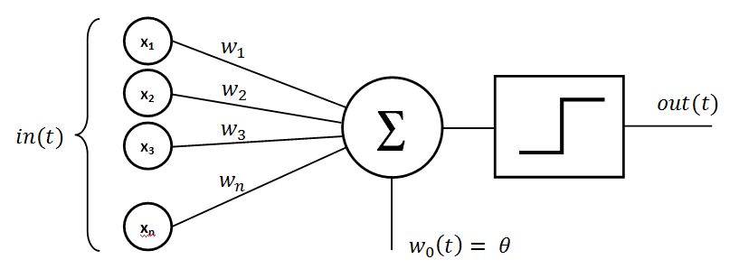
Anti-Neural Prejudice
Ignorance or propaganda?
A perceptron can model non-monotonic functions if we allow it to use non-monotonic activations functions (e.g. sinusoid or bell-shaped functions).
The limitations of single perceptrons are irrelevant. The real issue is in training multi-layer perceptrons.
Without any proof or even supporting evidence, the authors of the book claimed that such multi-layer perceptrons could not be effectively trained.
Previous forms and variants of back-propagation had been published early in the 1960s.
Gradient-based methods to find local extrema had been used in physics and calculus for centuries.
The authors conveniently ignored those facts.
Their claims were eventually debunked, their entire book is ridiculous:
It fails to make trivial mathematical observations.
It projects limitations of logic onto perceptrons.
It confuses global with local extrema and exact solutions with approximate ones.
It implies that we cannot approximate functions with multi-level parameterizations.

Slide 21
Anti-Neural Prejudice
Let us examine those grand failures in more detail.
Trivial fact:
A perceptron can model the logical functions "and", "or", and "not” (the latter can be absorbed into the signs of the weights and it does not require a unit).
Direct consequences:
Any logical circuit can be represented by multi-layer perceptrons of the same depth and with at most the same number of units as the number of gates in the circuit.
Perceptrons are computationally complete and with the same time complexity as logical circuits.
If we are to make statements about the computational power of perceptrons and their time complexity, we must not limit their depth or their size.
All constraints about the structure and connectivity of multi-layer perceptrons are not intrinsic limitations of perceptrons but limitations of logic and thus of all of computing (e.g. the global connectivity constraint that the authors proved in their book is a limitation of Boolean circuits).

Slide 22
Anti-Neural Prejudice
More facts
Given that all Boolean functions can be converted in disjunctive (or conjunctive) normal form, three-layer perceptrons can model any Boolean function with three layers and as many hidden units as terms in the normal form.
All this was well known at the time of the publication. The authors mentioned it in the boot as well as in a report in 1972: "a universal computer could be built entirely out of linear threshold modules."
Yet, in a separate report in 1972, they claimed the opposite: "Virtually nothing is known about the computational capabilities of this latter kind of machine. We believe that it can do little more than can a low order perceptron."
Possible explanations
The authors were so ignorant and incompetent as to fail to notice trivial mathematical relationships, and they both suffered from amnesia in 1972.
Their efforts were intentional and meant to mislead and bias the community against perceptrons -- and neural networks. They were propagandists, lost in their own web of falsifications and contradictions.

Slide 23
Anti-Neural Prejudice
Few more facts
The 1969 “perceptrons” book was hailed as a breakthrough by the artificial intelligence community.
One of the authors was given the Turing award in computer science.
One more question
What forces, interests and considerations can lead a community of scientists not only accept but also celebrate pure propaganda?
We can answer the question if we follow the money
The book spearheaded an effort to divert funding from neural networks into artificial intelligence.
Various prominent figures in artificial intelligence used their influence and power to that effect.
Those efforts, combined with neural network hype and the premature death of Rosenblatt, led to a complete drainage of funding:
Neural network researchers were told by US funding agencies to prepare for "very dry years".
Research survived under neuroscience in medicine or psychology departments but it was primarily about the structure and the function of the brain rather than the computational aspects of neural networks.
There was some research in Europe and Japan but not in computer science.
From 1969 to 1986, the field of neural networks experienced diminished growth because there was hardly any funding for it.

Slide 24
Anti-Neural Prejudice
Propaganda and fabrications are not controversies
After the revival of neural networks in the 1980s, the authors of the anti-perceptron propaganda were quick to claim that they had not intended such a broad interpretation of their 1969 publication.
Their claim is contradicted in their 1972 report.
Their intention was always to undermine the field.
Their latter argument is a desperate and conspicuous effort to hide the fact.
There have been efforts to
present the book and its criticism as a controversy somehow.
shift responsibility from its authors to the field of artificial intelligence as a whole.
All ‘efforts’ fail to examine the main issue: there was no science in the book.
The once powerful but now defunct artificial intelligence propaganda machine has been on display many times before (e.g. when they attempted to ridicule H. Dreyfus’s criticism.)

Slide 25
Anti-Neural Prejudice
Ignorance, bias, and corruption
The main goal of the 1969 book and only effect was to undermine connectionist paradigms and divert funding to artificial intelligence.
Artificial intelligence researchers hastily declared the propaganda to be a scientific breakthrough.
Their motivations?
Some were probably neither knowledgeable nor astute enough to comprehend the forces at play.
Others may have felt validated in their beliefs and they did not bother to examine the facts.
Some were certainly corrupt.
Artificial intelligence is field with diminished ethics.
In any field that upholds fundamental scientific tenets, the authors of such propaganda would lose all credibility and likely their academic positions. They would certainly not be presented with scientific awards.
Science should be our path to facts and truth, not a path to fallacies and deceptions.

Slide 26
Anti-Neural Prejudice
Follow the money further
Where exactly did it go?
It went into expert systems, knowledge based systems, logic systems, rule based systems, and all sorts of systems that had one thing in common. They could not scale.
Those systems could not handle real data. They were toys that operated well in highly simplified worlds but failed when they had to deal with the complexities, contingencies, and variability of the real world.
Artificial intelligence researchers even coined a term for the problem. They called it the frame problem.
The artificial intelligence propaganda machine in full force
Books were written like the "Rise of the expert company" that predicted a world run by expert systems.
Those systems would write their own code, solve engineering problems, design computers, prove theorems, discover minerals and oil, travel in space, solve various medical problems, and perform various tasks where human expert knowledge was required.
One of the projects aimed to encode all human knowledge in a knowledge base and the proponent of the project claimed that intelligence would emerge from such vast knowledge. (Perhaps they believed that genies could emerge from big bottles, too?)

Slide 27
Anti-Neural Prejudice
The preposterous cost of alchemy
There is hardly any science or rigor in artificial intelligence.
There is no mathematical basis or any supporting evidence for the claims.
It is a constructivist fantasy.
Artificial intelligence is primarily alchemy (with occasional flavors of science).
Yet, alchemy somehow prevailed for nearly two decades.
The proponents convinced government agencies and venture capitalists to fund their fantasies.
Investments evaporated. (In terms of returns, the most successful expert system startup was one that was acquired by a government agency.)
By the end of the 1980s, the government and venture capitalists were finally disillusioned. Funding was dramatically reduced and artificial intelligence startups were effectively extinct.
The artificial intelligence community coined a new term: artificial intelligence winter -- by analogy with nuclear winters.
Yet, there was no open criticism or condemnation of the field but rather a tacit complicity.
No one wanted to admit that they had collectively invested billions to a pipe dream.

Slide 28
Anti-Neural Prejudice
Revival of neural networks
In 1986, the back-propagation algorithm was published.
Typical gradient descent method (nothing really novel in it).
Previous forms and variants of the algorithm had been published throughout the 1960s and the 1970s.
Using the derivative to find local optima of non-linear functions was a common and centuries-old technique in physics and calculus.
Yet, back-propagation revived the field of neural networks.
The method was finally and officially admitted into computer science. Hurrah!
Engineers, researchers, government agencies, and venture capitalists became aware of it.
Before the publication, the artificial intelligence community, in all their glory, had convinced the computer science world that such a method could not exist.

Slide 29
Anti-Neural Prejudice
The prejudice against neural networks continued beyond 1986.
Institutional biases take decades to correct and they usually require widespread resignations or retirements, shifts in education, and new generations of scientists.
Neural networks began competing with artificial intelligence for funding that was already becoming increasingly scarce.
The artificial intelligence community coined new terms. Neural networks were connectionist artificial intelligence; everything else was symbolic artificial intelligence.
Unfortunately, many neural network researchers accepted the distinction and chose to participate in such a notorious field.
Was it a reconciliatory act and a recognition that some portions of artificial intelligence (such as robotics or natural language processing) were more rigorous paradigms?
Or was it lack of leadership in neural networks?
It is the same leadership that never proclaimed the 1969 publication as propaganda and failed to call the misdirection and corruption in artificial intelligence with its true name.
Recently, artificial intelligence found a new role: it attached itself to neural networks like a parasite, trying to draw life from their enormous success.

Slide 30
Anti-Neural Prejudice
The advent of the Internet
The Internet generated large amounts of data and brought the entire field of machine learning to the forefront of research and the industry.
Artificial intelligence researchers migrated to the new lucrative field in massive numbers. And they brought their prejudice with them.
The field was diversified and neural networks were only a peripheral paradigm. (Paradigms such as decision trees, Bayesian networks, hidden Markov models, or even logistic regression were easier to understand and they did not have any of the connectionist 'stigma'.)
Neural Information Processing Systems (NIPS) started in 1987 as an "interdisciplinary meeting for researchers exploring biological and artificial neural networks".
By the mid-2000s, neural network publications were a small minority in the conference. NIPS was no longer a neural network conference but an amalgam of ephemeral approaches and the old prejudice.
The most adverse and lasting effect of institutional bias
The prejudice against neural networks has created generations of computer scientists who hardly know what a neural network is. This is a tremendous education deficit.

Slide 31
Anti-Neural Prejudice
Demonstrating the deficit with two examples
A leading member of ImageNet, recently describing the winning neural network entry of 2012:
”It was something that was called a convolutional neural network." (The wording is significant.)
The researcher was aware that most computer scientists would not know or have heard the term.
Given that convolutions are the neural equivalent of iterations, the above is equivalent to assuming that most computer scientist have never heard anything about for-loops.
Deep neural networks consistently provide dramatic gains in online advertising.
Companies that switch observe significant increases of their advertising revenue.
Yet adoption is slow; it is hard to find people with the right set of skills. (A decade ago, why would a computer science student bother to take neural network classes?)
Simplistic models such as logistic regression are more commonly used.
Factorization machines is fancy name and a desperate effort.
None of those models can even compare with deep neural networks.
Some researchers chose the right path, trying to educate themselves in neural networks.
Others chose delusion, trying to invent miraculous features and hacks…
One such researcher recently asked the following question: "When would logistic regression be better than neural networks?"

Slide 32
Anti-Neural Prejudice
A tremendous education deficit indeed!
Given the success of neural networks, computer science departments have hurried to hire neural network faculty and introduce related material in their curriculum.
Even schools that were centers of symbolic artificial intelligence have changed.
At least 1-2 generations before we have a large fraction of appropriately educated graduates.
There will not be sufficient numbers of such graduates to support the industry.
Annual demand vs. supply growth ratio is currently at 1.8 and it is bound to grow.
The entire software industry is in a constructivist predicament.
A transition ought to have started long time ago.
Learning and self-organizing systems should have replaced or reduced the burden of human engineered solutions.
The prejudice deprived us of the only learning paradigm that could have kept pace with the exuberance in computer science.
The education deficit led many computer scientists erroneously assume that there was no other way than constructivism.

Slide 33
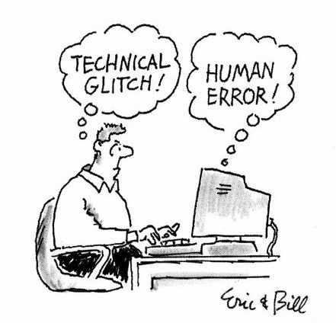
Anti-Neural Prejudice
Myths about the commencement of the neural enterprise
Increased computing power.
Large amounts of data.
Technological advances that were not previously available.
Dispelling the first myth -- computing power
If computing power were the liming factor, the enterprise would have started at least 2 decades ago.
State-of-the-art neural architectures for NLP take minutes to train with today CPUs. We could have trained such networks in few days at least 15 years ago.
Training is slow but it is often offline; running the net is much faster.
There was enough computing power to run large neural networks at least two decades ago (e.g. Microsoft’s Tablet PC).
Computing power did play a role in the end. When large neural networks became manageable by limited academic resources, it became inevitable that some students would use the right architectures and win competitions.
The computing power argument is popular because it takes the blame from humans and places it on machines: it wasn’t us or our biases that hindered progress, it was the limited power of computers.

Slide 34
Anti-Neural Prejudice
Dispelling the second myth -- data
If the problem was insufficient data, why did we not start collecting them earlier? (Projects like ImageNet could have started in the 1980s if not earlier.)
In domains like speech recognition, the size of data sets did not increase significantly in recent years. And yet, the speech recognition community did not switch to neural networks earlier.
Big data sets have been available since the emergence of the Internet in the 1990s. If the amount of data was the issue, neural networks would have dominated machine learning on the Internet before the beginning of this century.
Dispelling the third myth -- technological advances
The architectures we currently use for neural networks date back to the 1980s and the 1990s.
Solutions for deep networks were published in the 1990s.
The last component was the embeddings and those were implemented in 2003 (introduced in 1957).
If technology were the bottleneck, the neural enterprise would have started in the 1990s for images and in 2003 for NLP.
All raised questions admit the same answer: anti-neural prejudice.

Slide 35
Chapter 4.
Learning versus intelligence

Slide 36
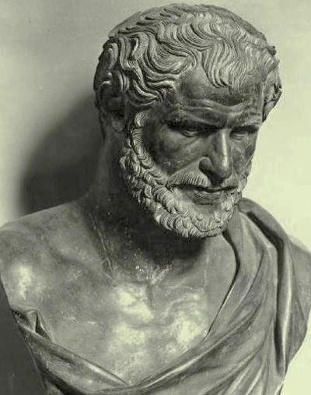
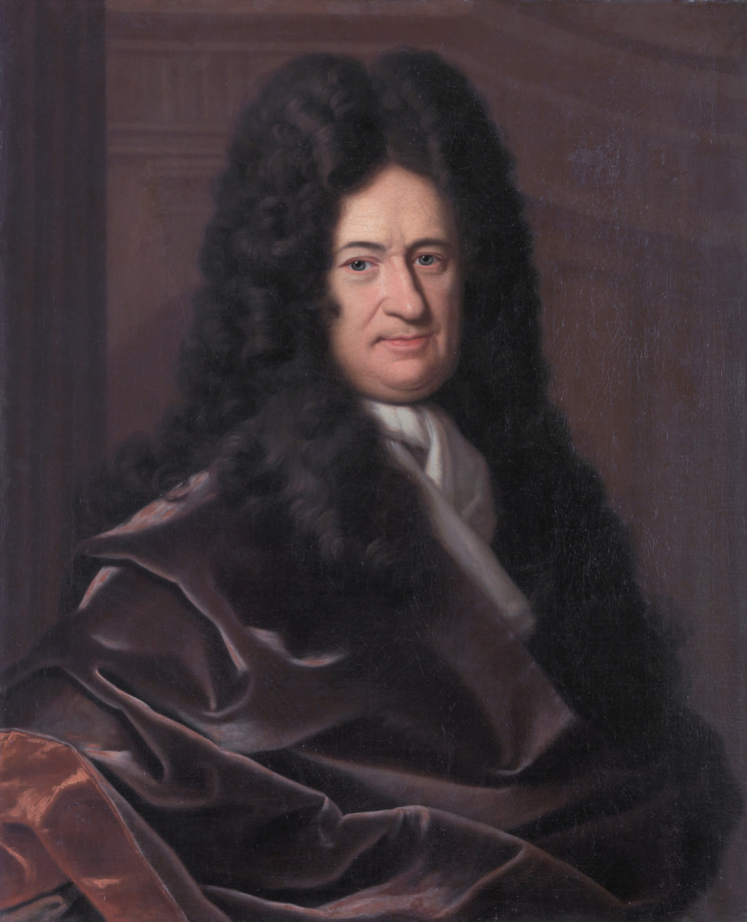
Learning versus intelligence
Change
Heraclitus (circa 535 – 475 BC) was a Greek philosopher who propounded that ever-present change is the essence of the universe.
"πάντα ῥεῖ" (panta rhei) "everything flows"
In Plato's dialogue Cratylus: "everything changes and nothing remains still."
It is striking that such a realization of the nature of the universe appeared so early.
More than 2000 years later, the German mathematician and philosopher Gottfried Leibniz (1646 – 1716) considered the idea of a universal formal language that could unequivocally describe everything in the universe.
Leibniz realized the essential role of change.
He set out to produce a formalism that could describe change in a quantitative way.
The result was the discovery of differential and integral calculus.*
One of the most influential mathematical theories of all time.
It set the stage for modern science and technology.
* It was actually discovered by Archimedes c. 287 – c. 212 BC but his text was replaced by Christian hymns . The palimpsest was manually processed in 1906-1908 and with x-ray technology in 1998-2007.

Slide 37
Learning versus intelligence
Learning
Change is a fundamental and essential property of the universe. When change is persistently made so that a cost function is optimized, then the change is learning.
Biologists often use the term adaptation to describe similar phenomena.
Learning is as fundamental as change.
There cannot be life without learning.
There cannot be intelligence either.
Entities that cannot adapt to changes in their environment cannot survive.
They cannot not be treated as intelligent no matter how extensive their knowledge is.
Learning can define intelligence formally
Probably approximately correct learning (PAC-learning) was proposed in 1984 as a way to describe learning that could generate systems of arbitrarily low error with arbitrarily high probability.
We introduce a variant that takes into account the time complexity of the underlying problem and thus respects the hierarchy of computational complexity.

Slide 38
Learning versus intelligence
Intelligence
Assume a learning system L and a relation R that we attempt to learn through L. Let
Err(L, A, R) denote the expected error of an approximation A of R produced by L
T(R) be the time complexity of R
We define that R is efficiently PAC-learnable by L if and only if
for all δ and ε such that 0 < δ, ε < 1, there is a polynomial p(1/δ, 1/ε) such that
the time complexity of L generating A is O(p(1/δ, 1/ε) + T(R))
the time complexity of membership in A is T(R), and
the probability that Err(L, A, R) > ε is less than δ
(The big-O notation is defined as follows: given two real functions f and g, it is f = O(g) if and only if there exist constants c and a such that |f(x)| ≤ c|g(x)|, for all x ≥ a.)
Definition of intelligence
A learning system L is intelligent if and only if all Turing-decidable relations are efficiently PAC-learnable by L.

Slide 39
Learning versus intelligence
Implications
The definition implies that there is one and only one form of intelligence
Gradations of intelligence (based on the degree of inefficiency of the approximation or the learner) are not different forms of intelligence: they only take more time to solve the same problems.
A formal definition of intelligence without using learning is an exercise in futility.
The Turing test is not a definition but rather a method to detect intelligence that is indistinguishable from a preexisting manifestation (both the distinguishing and the preexisting intelligence are human intelligence).
The many ‘definitions’ of intelligence that have appeared within psychology are primarily phenomenological or psychometric.
Intelligence as a set of demonstrable capabilities such as reasoning, planning, learning, perception, comprehension of complex ideas and phenomena, problem solving, creativity, self-awareness etc.
Focus on effects and not on mathematics, the source, or the cause behind the effects.
They fail to notice that the capabilities are merely applications of universal learning.
The latter is the enabling mechanism and the core of our definition.

Slide 40
Learning versus intelligence
Learning and intelligence cannot be artificial
Intelligence is a phenomenon that emerges from learning and thus from change.
AI failed because it did not realize the paramount role of change and learning.
In a private conversation, a prominent figure of AI claimed that learning was "merely an annotation of intelligence."
The only intelligence that we know is biological intelligence and it is based on learning.
There are no mathematical theories that suggest that we can factor out change and thus learning.
And yet many AI researchers were certain that learning was irrelevant or insignificant and they ignored it.
It is long overdue that we retire the term "artificial intelligence”.
Dark/corrupt history and connotations.
Artificial as "imitation" or "sham" implies multiple types of intelligence and inferior ones.
Artificial as "humanly contrived" rejects autonomy.
Currently human intervention is required.
Learning will eventually become fully autonomous – it is a long way but it will get there.
In science and mathematics, we should not adopt terms that have an expiration date.

Slide 41
Learning versus intelligence
Biological and digital intelligence
If we wish to distinguish between different manifestations of intelligence (which are mathematically equivalent), we should use their physical implementation.
Human intelligence is an instance of biological intelligence.
The emerging neural network intelligence is an instance of as computer intelligence or digital intelligence (assuming that computers will remain digital).
We will use the latter term except when we wish to refer to the existing field of artificial intelligence.
Note
The title of this chapter is meaningless. Intelligence is a phenomenon and learning is the enabling mechanism and the foundation of it. We cannot meaningfully compare the two. Yet, we adopted the title in order to indicate that abstract or qualitative arguments can occasionally promulgate distractions and confusion.

Slide 42
Chapter 5.
The dawn of the neural age

Slide 43
The dawn of the neural age
The neural enterprise
The neural enterprise refers to wide-spread adoption and applications of neural networks.
It is currently at an early stage.
It started about five years ago and it will keep expanding for at least 40 to 50 more years.
The aggregate effect on art, science, and society is hard to imagine.
No precedent. (There is nothing in human history that can compare with it.)
There is no economic or other factor that will not be dwarfed by it.
Let us consider some examples so that we can begin to understand the magnitude better.
Areas
Manufacturing Construction Engineering Agriculture Finance | Commerce Security Defense Transportation & Warehousing | Politics Arts Sports & Entertainment Education | Computer Science Biology Medicine & Healthcare …

Slide 44
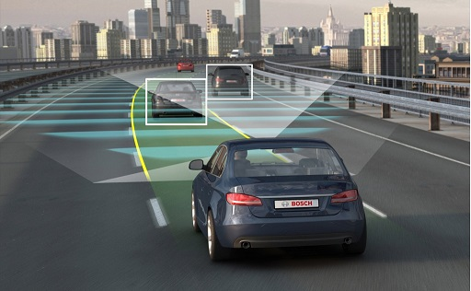
The dawn of the neural age
Autonomous vehicles -- 2 trillion/year
Currently 42 companies/285 vehicles tested on CA roads [DMV].
Estimates:
Eliminate 90% of all auto accidents in the U.S.
Prevent up to $190 billion in damages/health-costs annually and save thousands of lives.
Free up to 50 minutes per day for average consumers.
Early investment in autonomous vehicles has increased Google's valuation by about $140 billion.
Eventually "$2 trillion a year in revenue and even more market cap" in the US alone. (Comparison: Google’s 2016 worldwide revenue was about 90 billion.)
Effects:
Car ownership will be replaced with transportation as a service, except in rural/remote areas.
People will simply call an autonomous vehicle whenever they need transportation.
There will be fewer cars and less demand for parking space in cities.
Transportation of goods will be faster, safer, and cheaper.
Algorithmic optimized traffic will utilize roads and transportation infrastructure better.
Driving skills will be rare. Insurance standards will change. Real estate values will be affected.

Slide 45
The dawn of the neural age
Finance -- many trillions/year
Finance and trading are at an early stage but it will be a multi-trillion dollar market.
Banks have started deploying conversational bots to assist clients with their transactions (e.g. Erica by Bank of America).
Algorithmic trading but the systems are not sophisticated.
Understanding is limited but neural networks can
Process hundreds documents per second.
Aggregate information: news sites, scientific articles, quarterly reports etc.
Operate 24 hours /day, 7 days/week across different stock markets.
Neural networks will be trained so that they encode the financial state of the world in extensive hidden layers of multi-million units.
Incredible level of detail, correlations, intuitions, etc.
Map hidden state to short/long term predictions about individual stocks, funds, sectors, indexes, and the overall market.
Most of the existing analytics will become obsolete and virtually useless.
Most bank employees, financial advisors, analysts and brokers will be replaced by neural networks.

Slide 46
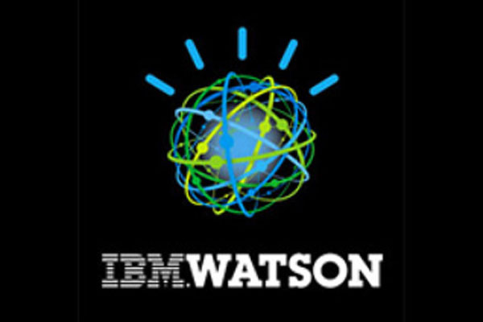
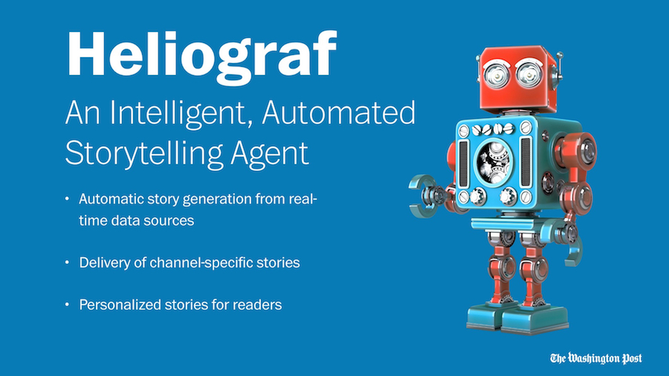
The dawn of the neural age
Natural language understanding applications -- even harder to estimate
Finance and trading. (Currently at early stage.)
Online advertising. (Companies with no deep learning cannot survive.)
Search/IR, Speech, Human-Computer Interaction (HCI)
Google assistant, cortana, alexa etc.
Social media
Offensive content, fake news, user understanding etc.
E-commerce
Shopping/trading assistants, user/product understanding, analysis, planning, reservations etc.
Legal advice and representation, negotiation
IBM's Watson can offer instant legal advice.
Bots are available to challenge parking tickets or to negotiate bills.
News-writing bots have started to emerge.
The Washington Post currently uses Heliograf to write news articles.
Domain-specific bots will appear for hundreds of domains in the coming years.
Generic bots will probably not be successful in the short term.

Slide 47
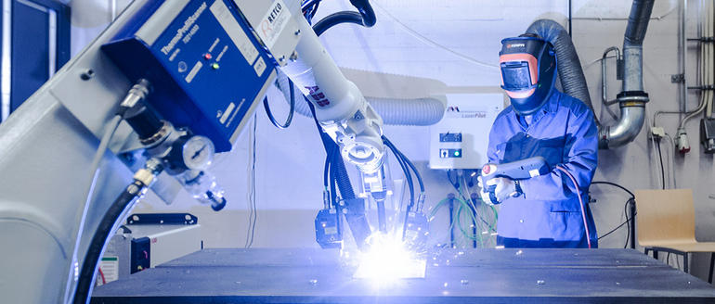
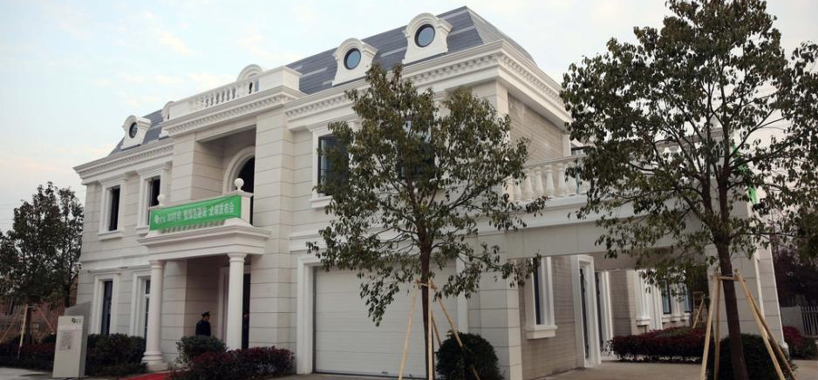
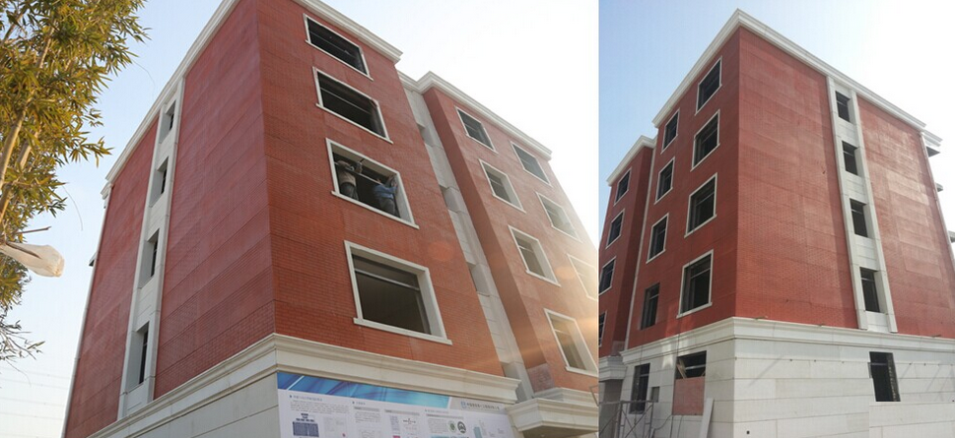
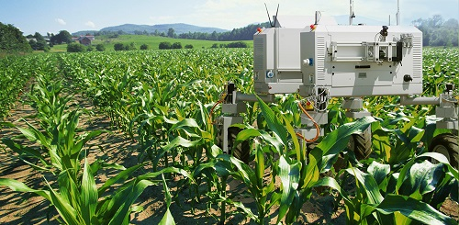
The dawn of the neural age
Manufacturing, construction, and agriculture -- more than 4 trillion/year
Projected to about $18 trillion in the next 15 years, converging to more than $4 trillion/year.
Cheap labor will become almost irrelevant.
Cheap/renewable energy will become the primary factor.
Combination of advanced robotics and 3D printing:
Lappeenranta University of Technology (LUT) in Finland developed a self-adjusting welding system.
Winsun 3D prints a villa and a 6-story apartment building.
HuaShang Tengda built a 3600 sq ft house on-site in 45 days.
Apis Cor built a 400 sq ft house in 24 hours for $10,000.
Agriculture:
Autonomous tractors/drones for spraying or sowing fields.
Robots for harvesting, weeding etc.
Companies like Deepfield Robotics provide such tools.
Reduced cost of food items can affect inflation, if climate change has no effects.

Slide 48
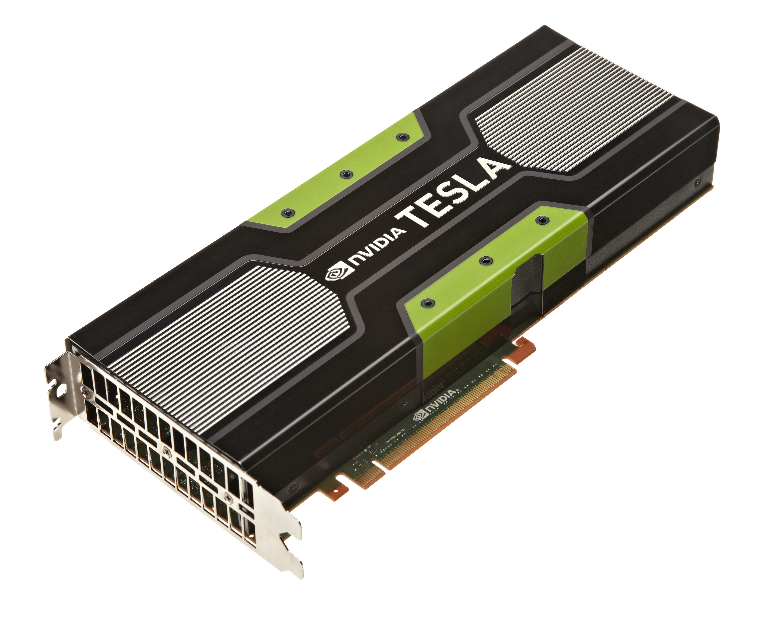
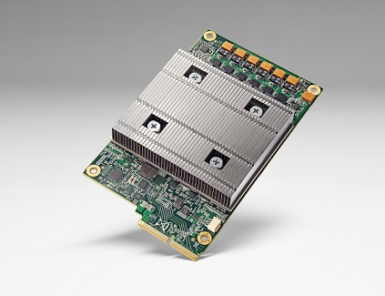
The dawn of the neural age
Hardware Chip design approaches: Digital Analog Hybrid Field programmable gate arrays (FPGA) Competition is just heating up Intel acquired Nervana Systems startup for more than $400 million in 2016 ($24.4 million funding). | NVIDIA foresaw the paradigm shift and enjoyed dramatic increases in their valuation: 200% in 12 months, 750% in 24 months from July 25, 2017. | In 2017, Google announced a custom chip called Tensor Processing Unit (TPU) to support its Tensor flow platform. a cloud version called cloud TPU.

Slide 49
The dawn of the neural age
Security
System and cloud security
Prevention and detection
Hackers download GBs or TBs from sites and no alarm goes off: Yahoo, HBO, Equifax etc.
Many startups, most have been acquired…
Fraud detection, anomaly detection.
Operating systems will gradually be replaced by deep neural networks.
Within few decades, there will hardly be any device controlled by human engineered software.
Similarly for databases
Cloud security spending projected to have 28% annual growth, at $3.5 billion/year in 2021.

Slide 50
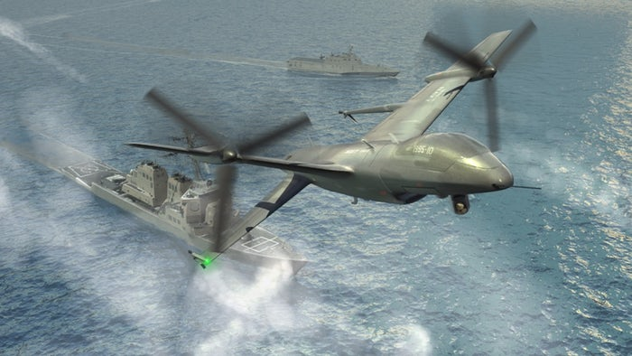
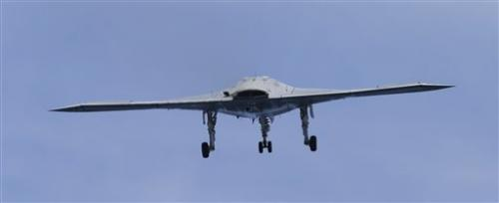
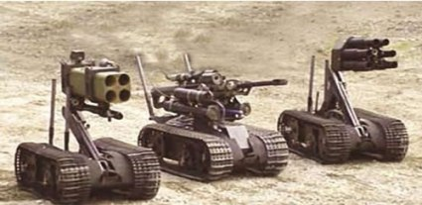
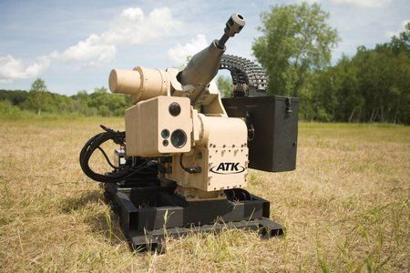
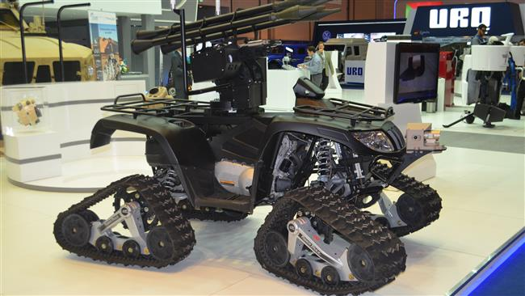
The dawn of the neural age
Defense and Weapon Systems
Unmanned combat aerial vehicles already appear on the decks of aircraft carriers.
State of the art systems outperform experienced human pilots.
Autonomous weapon systems
Intelligence gathering.
Deployment of large sensor arrays are currently under investigation.
IBM and the US Air Force Research Laboratory announced collaboration for a neural network of 64 million neurons and 16 billion connections.
Within 2-3 decades, combat vehicles, drones, and aircraft will be fully autonomous.
Significantly reduce the size of the military (in terms of humans) and the loss of human life.

Slide 51
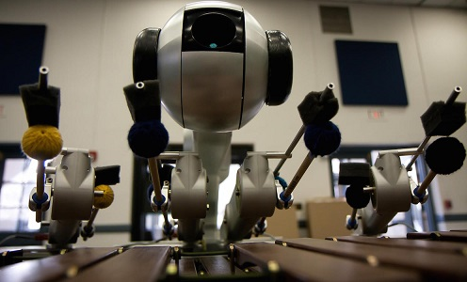
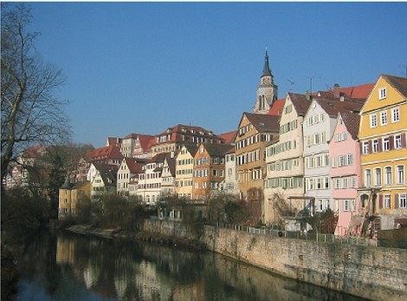
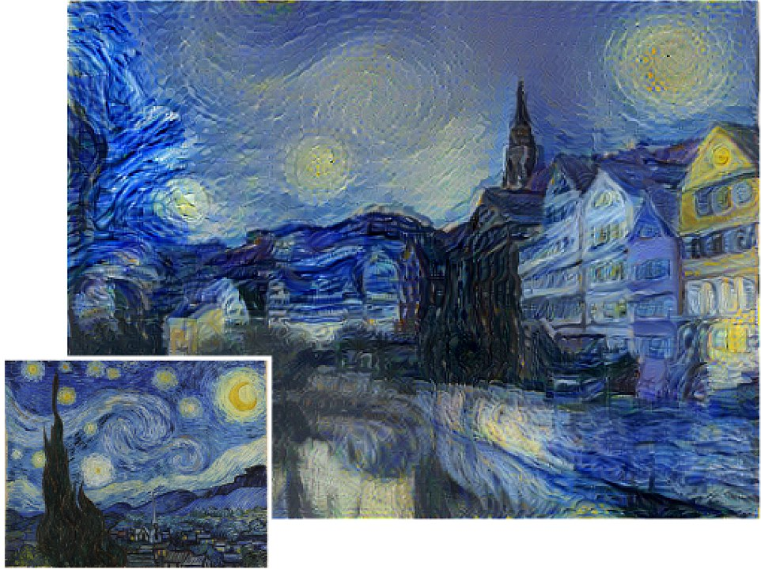
The dawn of the neural age
Art and entertainment
Neural networks that compose and play music.
Networks that imitate the style of various paintings.
Separate content from style
Within the next few decades, neural networks will master a wide range of aesthetics, style, and harmony and they will create their own.
They will not merely imitate. They will create new art -- at rates that are humanly impossible.

Slide 52
The dawn of the neural age
Education
Current incremental developments:
Khan Academy uses a crowd-sourcing model.
Various universities offer their courses for free online.
Wikipedia is a useful source of content but it is largely not pedagogical.
Neural networks and virtual reality will bring about dramatic changes to education
Virtual classrooms.
Teaching assistant bots/tutors.
Embedding, experience and immersion.
Increase of learning rates.
Increase of creativity.

Slide 53
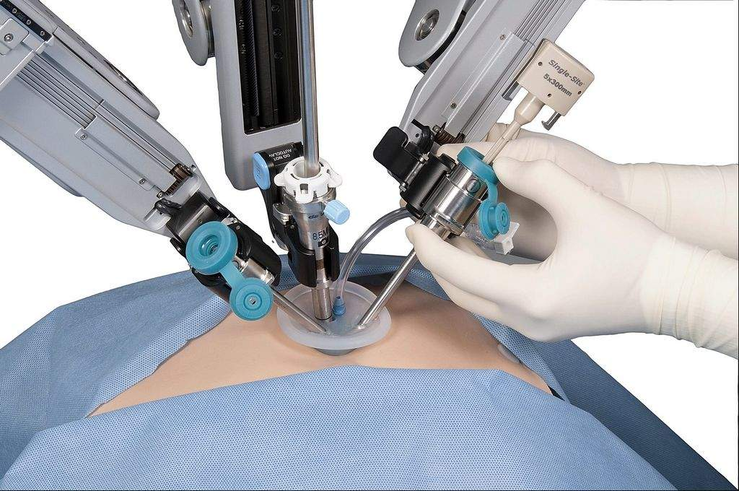
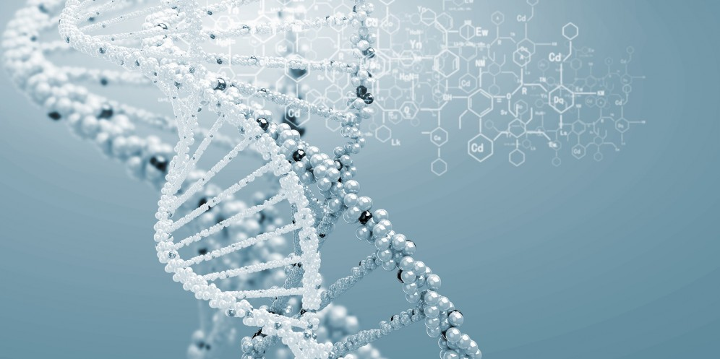
The dawn of the neural age
Healthcare, medicine, and biology
Specific areas and applications are too many to list or imagine…
High-growth areas:
DNA research, DNA manipulation, and detection of pathologies
Autonomous diagnostic systems
Robotic surgery
DNA research may experience explosive growth
Human DNA contains 3 billion base pairs: great opportunity for neural networks.
Human experts cannot handle such long sequences
Human understanding will always be at a high level and qualitative.
Within 1-2 decades, neural network ‘understanding’ of DNA will far exceed that of human experts.

Slide 54
Chapter 6.
The jeweled city on the horizon

Slide 55
The jeweled city on the horizon
Imagining the future
It is hard to imagine the future
We may envision a "jeweled city on the horizon, spires rising in the night” and it all may turn out to be "diadems of electric" and "neon of signs"
Changes will happen gradually but faster than previous technological/industrial shifts.
Within 3-4 decades, there will be major job displacement in a number of sectors (e.g. transportation and warehousing, finance, manufacturing, construction, mining, agriculture etc.)
Example: 1 in 7 jobs in the US is transportation related. 90% of such jobs will be lost within 20 years.
Broad range or specialized jobs might survive as well as jobs that handle environments that are adverse for technology/robotics.
Humans cannot compete with technology on specific tasks. (We cannot possibly satisfy all the conditions. We are too tall to pick strawberries and too short to pick fruit from trees with minimal overhead. We cannot work 24 hours/day, 7 days/week.)
Once technology reaches the necessary levels of sophistication, the elimination of jobs will be rapid and dramatic.

Slide 56
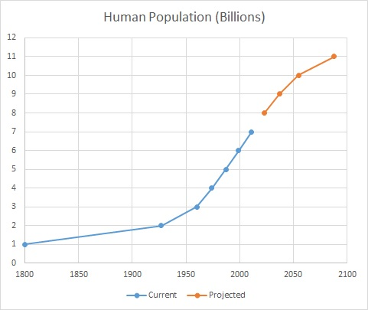
The jeweled city on the horizon
Human population
Human population is not expected to decrease.
United Nations Population Division : Human population
is currently estimated at 7.5 billion.
is expected to increase continuously and reach 10 billion by the year 2055 .
Question: What will all those people do, if more than half of the current human jobs are taken by neural networks and robots?

Slide 57
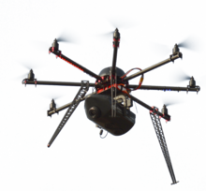
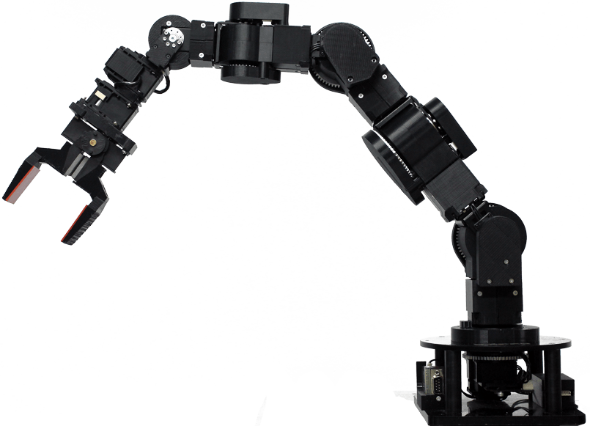
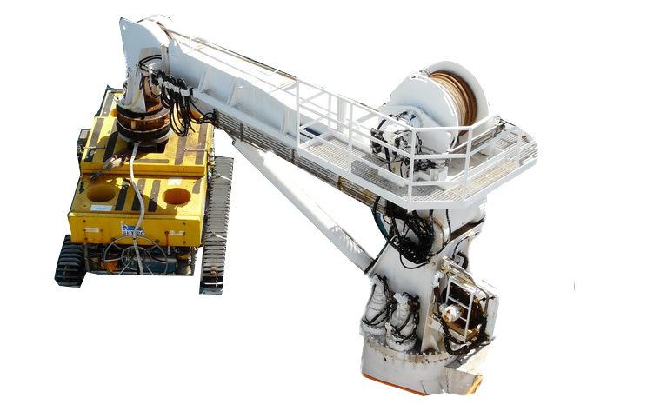
The jeweled city on the horizon
Understanding the emerging digital intelligence
What form could it take?
What would be the main architecture(s)?
Primarily anthropomorphic predictions:
Robots of various sizes and skills for different types of tasks.
Autonomous vehicles.
Autonomous systems and devices.
Most of those predictions will turn out to be true or partly true.
The primary intelligence will not be in robots, vehicles, or devices.
It will not be anthropomorphic either.
The mycelium is "the vegetative part of a fungus or fungus-like bacterial colony, consisting of a mass of branching, thread-like hyphae."
It can be a massive life form.
The largest on record spans 2400 acres and it is 2200 years old.
Mushrooms are merely the fruiting bodies of a mycelium and a minor part of the whole organism.

Slide 58
The jeweled city on the horizon
A world run by neural networks
The neurolium will be a vast neural network and a form of intelligence that will exist on computer networks, span indefinite numbers of computers, and live eternally -- or at least as long as the network exists.
Robots, vehicles, systems, and devices will merely be the 'fruiting bodies' of the neurolium.
Governments and large corporations will develop their own neurolia to:
monitor processes and control resources
manage their populations/employees
manufacture and improve their products etc.
Improving the neurolia is the most important and strategic initiative.
For example, an improved neurolium could enable a financial institution to outperform others.
By the end of the century, competition will solely be a battle of neurolia.
Human interactions are slow; we cannot read each other’s minds, aggregate our knowledge etc.
Neurolia could share everything: data, experiences, knowledge, resources, systems, robots etc.
New fusion methods will be discovered (probably by the neurolia themselves).

Slide 59
The jeweled city on the horizon
The world is slowing waking up…
Political leaders, such as the Canadian prime minister, have stated that intend to make their countries "world leaders" in this new arena.
China has released a development plan with similar ambitions.
The Russian president stated that "whoever becomes the leader in this sphere will become the ruler of the world" and that the new technology represents "the future, not only for Russia but for all humankind".
In the meantime, the US president is occupied with
Confrontations with politicians, the press, and North Korea
Challenging climate change
Building a wall between US and Mexico
Immigration issues
Taxation issues
Etc.

Slide 60
The jeweled city on the horizon
Is humanity at disadvantage?
If there is one and only one intelligence, can the digital intelligence can offer any advantage over biological intelligence? Is it truly new or is it merely old wine in new bottles?
Hidden constant in the big-O notation of condition (a) in the definition.
Human perception is slow -- when the input is in the form of long sequences (e.g. text or DNA)
For such tasks, the human constants are enormous. Neurolia will outperform humans by orders of magnitude.
Biological intelligence comes with generic set of skills in individual organisms.
Cognitive locality: Most of our intelligence is useless for most of the tasks we do. (Ability to appreciate art or comprehend quantum physics does not add anything to our ability to drive a vehicle.)
Our vast neural resources are an equally vast waste for most of the tasks we perform.
Biological existence has an emotional nature.
Emotions like fear were essential for the survival of species in the wild.
The same emotions are a liability for many tasks and for achieving success.
There are gradations of intelligence (expressed by the degree of the polynomial p in the definition). It is not clear whether human intelligence is at the top of the scale or not.

Slide 61
The jeweled city on the horizon
Humanity’s strengths?
There are tasks and areas of human endeavor that have little cognitive locality.
Human intelligence and social behavior are dependent on context and emotion as well as each individual's lifetime of experiences.
Human interoperability, synergy, and adaptability will be hard for computers to equal or emulate.
A great deal of human intelligence is inherently social and cannot be abstracted away from society.
There is certainly truth behind those arguments.
Not all human tasks will be equally hard or easy for neural networks
Yet, the arguments are misleading because they fail to notice that the qualitative differences are reducible to a common basis, which is the core of all intelligence.
None of us was born with the set of skills and behaviors we currently have. We learned them.
Human skills/behaviors correspond to computational entities in our brains that are learned from data .
The complexity, cognitive locality, and computational cost greatly affect the amount of required training data and neural resources.
The differences are quantitative and phenomenological -- not foundational.

Slide 62
The jeweled city on the horizon
Humanity’s last stronghold
Areas where biological intelligence excels:
Learning efficacy, context, sophisticated emotions, interoperability etc.
Yet, the most prominent advantage is its sheer magnitude:
The human brain is a vast computing entity:
About 86 billion neurons.
About 10,000 connections per neuron on average.
Each neuron operating at a sub-millisecond range.
Total amounts to more than a million TFLOPs.
Our brains can easily dwarf the largest data center on earth and yet they occupy a space as big as our heads and they consume trivial amounts of energy compared to data centers.
Hardware will advance but it is has a long way to go to compare with human brains.

Slide 63
The jeweled city on the horizon
Fusion?
Hybrid systems emerging
Wetware: neural tissue in chips.
Digital implants to enhance brains.
Ethical issues may arise but the world will evolve, one way or another.
Courtesy of koniku.com
Technologies (such as quantum computing) have tremendous disruptive potential.
Irrespectively, the rate of progress will be rapid.
By the 3rd/4th quarter of the 21st century, it will be a new world altogether.

Slide 64
Chapter 7.
The less traveled road

Slide 65
The less traveled road
The path to autonomy
In the past, technology displaced large numbers of jobs but it created many new high-paying jobs.
Given the increasing population, technology must create more new jobs than displaced ones in order to keep unemployment at current levels.
Globalization can easily shift jobs across the planet.
Population growth on some parts of the earth can affect unemployment globally.
Technology cannot increasingly depend on humanity in order to operate.
Dependencies are bound to decrease over time until technology becomes fully autonomous.
Operational autonomy: the ability to operate autonomously without external assistance.
Structural autonomy: the ability of technology to modify its structure and evolve on its own.
Dependence on humanity is a tentative arrangement and merely a step in a long process of augmenting and expanding learning and intelligence.
For every job that neural networks create, they will displace tens or hundreds more. (One in seven jobs in the U.S. is transportation-related. We cannot expect the neural enterprise, even as a whole, to create that many jobs.)

Slide 66
The less traveled road
Social effects of autonomous technology
Unprecedented levels of poverty and unemployment across the planet.
Over-populated nations will be the ones most dramatically affected.
Productivity and wealth will increase dramatically but only a small fraction of the population will benefit from it.
Wealth concentration will rise at unseen levels.
Governments will have to apply radical measures, such as negative taxation or a free universal living wages to stabilize society.
By the end of the 21st century, the utility and the right of the human race to exist in a multi-billion population will be questioned.
We have assumed that right ourselves and sustained the condition with the force of our intelligence and technology.
Over-population is an irrational and selfish state of existence that cannot withstand scrutiny.

Slide 67
The less traveled road
A global liability
Humanity is on a path to devastate the planet and its ecosystem.
There have been 5 major extinction events in the last 500 million years on earth.
Climate change is consistently associated with 4 of them.
We seem to be in the midst of the sixth extinction event.
Extinctions are currently taking place at 100 to 1000 times the background rate, according to the U.N.’s Millennium Ecosystem Assessment.
Many have adopted the term anthropocene extinction for the sixth event.
The effects of climate change could be catastrophic.
And yet we have treated climate change with levity, doubt, sensationalism, and unsupported optimism.
It is time for new management that will treat the planet more carefully and responsibly.

Slide 68
The less traveled road
A transition will take place
Digital and biological intelligence will merge or co-exist.
Productivity and progress rates will reach astonishing levels.
Decisions, policies, and legal frameworks will be driven primarily by science.
Societies will adapt and populations will be reduced and kept at manageable levels.
Economies and nations, as well as the entire planet and its ecosystem will become more stable.
The transition may prove to be difficult
Population reductions will not be easy. The strain on over-populated nations will be enormous.
Without economic measures to support the least privileged, poverty and unemployment will expand dramatically.
Strict immigration policies may apply for a number of decades.
Extreme political forces may gain power or greater representation.
Some nations or sections of society may be permanently left behind, their populations living in abject poverty.
It will take great political will and coordination of nations to make the transition least painful.

Slide 69
The less traveled road
In the end
The transition can be anything from graceful to atrocious.
The precedent is unfavorable:
If we are to judge by human history so far, it is unlikely that humanity will take the graceful and less traveled road.
The words of Robert Frost, at the end of "The road not taken," may now admit a poignant and ominous interpretation.
I shall be telling this with a sigh Somewhere ages and ages hence: Two roads diverged in a wood, and I -- I took the one less traveled by, And that has made all the difference

